Slide 1
Who Represents me?
SS.7.C.3.8—Analyze the structure, functions, and process of the legislative, executive, and judicial branches.
SS.7.C.3.9—Illustrate the lawmaking process at the local, state, and federal levels

Slide 2
Today’s goal
Compare local, state, and federal lawmakers
Local(city council/county commissioners);
state legislators (Representatives and Senators);
US Congressmen/congresswomen (representatives and senators)

Slide 3
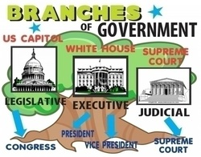
The Federal Government

Slide 4
The Federal Government
Who is our current President?
What is his main responsibility?

Slide 5
The Federal Government
Barak Obama
The president represents the people of the United States. His job is to make decisions in the best interest of the entire nation

Slide 6
The federal government
Who are our current U.S. senators from Florida?
Marco Rubio—R
Bill Nelson—D
What is a Senators main job?
Make laws for the entire country and represent their state in Congress
Who do Senators represent?
Constituents –People politicians have been elected to represent

Slide 7
The Federal Government
Marco Rubio—D
Bill Nelson--R
U.S. Senators make laws for the entire country. They represent their state in Congress

Slide 8
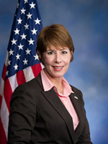
The Federal Government
How many congressional districts does Florida have?
27
Which District does Bay County Belong to?
District 2
Who is our current U.S. Representative?
Gwen Graham

Slide 9
The Federal Government
2
Gwen Graham--D
U.S. Representatives make laws for the entire country. They also represent their state and district in Congress

Slide 10
You should have completed the top have of your paper for the Federal Government.
Moving on to State Government

Slide 11
State Government
Who is our Current Florida Governor?
Rick Scott
What is his main job?
He is in charge of the entire state of Florida. His job is similar to the President.

Slide 12
The State Government
Rick Scott--R
The governor is in charge of the entire state. Similar to the U.S. President

Slide 13
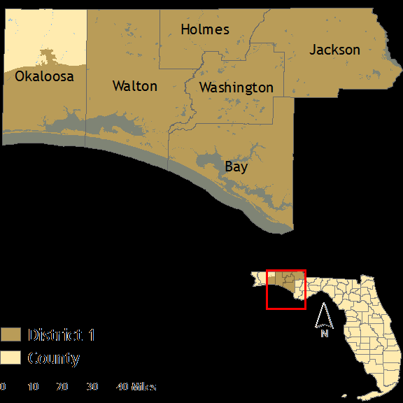
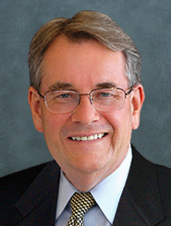
State Government
Florida State Senate:
We are currently living in District 1
Who is our Senator that represents this area?
Don Gaetz
What do Florida senators do?
State senators make laws for their state and represent their district.

Slide 14
State Government
1
Don Gaetz—R
State Senators make laws for their state with the interests of the constituents of their district
Constituents—People they represent

Slide 15
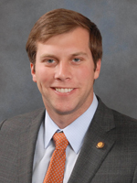
State Government
Florida State House of Representatives:
We are currently living in District 6
Who is our State Representative that represents this area?
Jay Trumbull (Elected Nov 2014)
What do Florida Representatives do?
State representatives make laws for their state and represent their district.

Slide 16
State Government
6
Jay Trumbull
State Representatives are in charge of making laws for our state and representing the voters in their district

Slide 17
You should have completed the second half of your paper on State Government
Moving on to local government

Slide 18
County Government
What County do we live in?
Bay County
There are 5 districts in Bay County, each district is represented by a County Commissioner.
The current commissioner for this area is: Guy Tunnell and he represents district 4

Slide 19
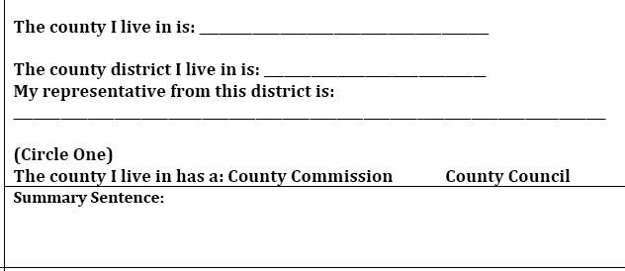
County Government
Bay
4
Guy Tunnell
County commissioners are in charge of making ordinances or laws for the county or district in which they represent.

Slide 20
City Government
You probably do not live within city limits but the largest city within Bay county is Panama City.
Southport is not an incorporated city because it does not have a city government. The Southport area is ran by the county.
Panama city has a Mayor who is in charge and several city commissioners that are all elected to run the city. Their main job is to represent citizens within the City and make ordinances.

Slide 21
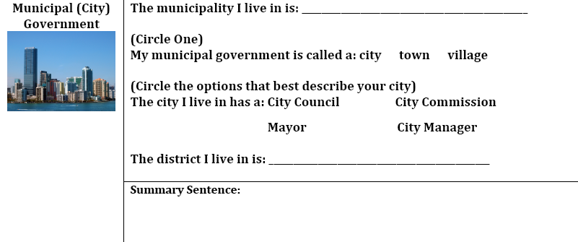
City Government
Panama City
District 5

