Slide 1
SS.7.C.2.9: Evaluate candidates for political office by analyzing their qualifications, experience, issue-based platforms, debates, and political ads
Students will identify the constitutional requirements to run for federal political office.
Students will recognize the requirements to run for state and local political offices
Students will be able to analyze and/or evaluate the qualifications of candidates for public office based on their experience, platforms, debates, and political advertisements.

Slide 2
Bellwork:
This is an excerpt from Article II of the U.S Constitution:
No Person except a natural born Citizen, or a Citizen of the United States, at the time of the Adoption of this Constitution, shall be eligible to the Office of__________________; neither shall any person be eligible to that Office who shall not have attained to the Age of thirty five Years, and been fourteen Years a Resident within the United States.
On a sticky note, answer the following questions:
What do you think goes in the blank?
What is a “natural born citizen”?

Slide 3
Timed pair share
With your shoulder partner, you have 30 seconds to share your bellwork responses.
The tallest person goes first!
What do you think goes in the blank?
What is a “natural born citizen”?

Slide 4
identify the constitutional requirements to run for federal political office
This is an excerpt from Article II of the U.S Constitution:
No Person except a natural born Citizen, or a Citizen of the United States, at the time of the Adoption of this Constitution, shall be eligible to the Office of PRESIDENT; neither shall any person be eligible to that Office who shall not have attained to the Age of thirty five Years, and been fourteen Years a Resident within the United States.
These are the constitutional requirements for the office of the President.

Slide 5
identify the constitutional requirements to run for federal political office
Everyone needs a copy of this activity sheet!

Slide 6
identify the constitutional requirements to run for federal political office
3 | U.S. Constitution | Article II, Section 1 No Person except a natural born Citizen, or a Citizen of the United States, at the time of the Adoption of this Constitution, shall be eligible to the Office of President; neither shall any person be eligible to that Office who shall not have attained to the Age of thirty five Years, and been fourteen Years a Resident within the United States.
 | Political Office
 | Constitutional Requirements
Read each excerpt.
Identify the political office that is being described.
List the requirements for that office based on what you read
Notes:
Model the constitutional requirements for president with the students (Box 3).

Slide 7
identify the constitutional requirements to run for federal political office
3 | U.S. Constitution | Article II, Section 1 No Person except a natural born Citizen, or a Citizen of the United States, at the time of the Adoption of this Constitution, shall be eligible to the Office of President; neither shall any person be eligible to that Office who shall not have attained to the Age of thirty five Years, and been fourteen Years a Resident within the United States.
 | Political Office
 | Constitutional Requirements
Read each excerpt.
Identify the political office that is being described.
List the requirements for that office based on what you read
PRESIDENT
A natural born citizen, at least 35 years old, and a resident of the United States for at least 14 years.
Notes:
Model the constitutional requirements for president with the students (Box 3).

Slide 8
identify the constitutional requirements to run for federal political office
Use the following instructions to complete boxes 1-5 with your shoulder partner.
Read each excerpt. (Partner A read 1 and 4, Partner B read 2 and 5.)
Identify the political office that is being described.
List the requirements for that office based on what you read.

Slide 9
Lets Check our work!
U.S. House of Representatives
25 years old, citizen for 7 years, live in the state they represent

Slide 10
Member of the U.S. Senate
30 years old, a citizen for 9 years, live in the state they represent
The President
Natural born citizen, 35 years old, resident of the US for at least 14 years

Slide 11
Florida Legislators (Senators and Representatives)
21 years old, live in district they represent, live in state for at least 2 years before election
Governor, Lieutenant Governor, Cabinet Members
The governor, Lieutenant Governor, and cabinet members must be at least 30 years old and live in the state for at least seven years

Slide 12
Political offices
Learning Goals
  Students will identify the constitutional requirements to run for federal political office.
  Students will recognize the requirements to run for state and local political offices
  Students will be able to analyze and/or evaluate the qualifications of candidates for public office based on their experience, platforms, debates, and political advertisements.
What are some of the political offices you have read about?
Look at our learning goals…what have we not read about?

Slide 13
Students will recognize the requirements to run for state and local political offices
6 | Florida Statute Title IX, Chapter 99: Candidates | 99.021 Form of candidate oath.— (1)(a)1. Each candidate, whether a party candidate, a candidate with no party affiliation, or a write-in candidate, in order to qualify for nomination or election to any office other than a judicial office as defined in chapter 105 or a federal office, shall take and subscribe to an oath or affirmation in writing…
 | Summary of Text
Listen as I read this excerpt from Florida statute.
As I read, underline key terms to help you summarize the excerpt.

Slide 14
Students will recognize the requirements to run for state and local political offices
6 | Florida Statute Title IX, Chapter 99: Candidates | 99.021 Form of candidate oath.— (1)(a)1. Each candidate, whether a party candidate, a candidate with no party affiliation, or a write-in candidate, in order to qualify for nomination or election to any office other than a judicial office as defined in chapter 105 or a federal office, shall take and subscribe to an oath or affirmation in writing…
 | Summary of Text
Listen as I read this excerpt from Florida statute.
As I read, underline key terms to help you summarize the excerpt.
All candidates, except judicial, have to take an oath qualifying them as a candidate for the office they are seeking.

Slide 15
Students will recognize the requirements to run for state and local political offices
Read the candidate oath with your partner.
Summarize the requirements for a candidate in the Summary of Text box below the oath.
Candidate Oath State of Florida County of Before me, an officer authorized to administer oaths, personally appeared (please print name as you wish it to appear on the ballot) , to me well known, who, being sworn, says that he or she is a candidate for the office of ; that he or she is a qualified elector of ______ County, Florida; that he or she is qualified under the Constitution and the laws of Florida to hold the office to which he or she desires to be nominated or elected; that he or she has qualified for no other public office in the state, the term of which office or any part thereof runs concurrent with that of the office he or she seeks; that he or she has resigned from any office from which he or she is required to resign pursuant to s. 99.012, Florida Statutes; and that he or she will support the Constitution of the United States and the Constitution of the State of Florida. (Signature of candidate) (Address)
7 | Summary of Text
 | Definition of Florida Elector

Slide 16
Students will recognize the requirements to run for state and local political offices
Read the candidate oath with your partner.
Summarize the requirements for a candidate in the Summary of Text box below the oath.
Candidate Oath State of Florida County of Before me, an officer authorized to administer oaths, personally appeared (please print name as you wish it to appear on the ballot) , to me well known, who, being sworn, says that he or she is a candidate for the office of ; that he or she is a qualified elector of ______ County, Florida; that he or she is qualified under the Constitution and the laws of Florida to hold the office to which he or she desires to be nominated or elected; that he or she has qualified for no other public office in the state, the term of which office or any part thereof runs concurrent with that of the office he or she seeks; that he or she has resigned from any office from which he or she is required to resign pursuant to s. 99.012, Florida Statutes; and that he or she will support the Constitution of the United States and the Constitution of the State of Florida. (Signature of candidate) (Address)
7
 | Definition of Florida Elector:
Summary: A candidate must sign an oath stating that they are an elector for the county where they live, they are qualified to hold office, they are not running for another office and that they will support the U.S. and Florida Constitutions.

Slide 17
Students will recognize the requirements to run for state and local political offices
Read the candidate oath with your partner.
Define the term “elector”. If needed, break the word into parts!
The suffix –or means “one who”.
Candidate Oath State of Florida County of Before me, an officer authorized to administer oaths, personally appeared (please print name as you wish it to appear on the ballot) , to me well known, who, being sworn, says that he or she is a candidate for the office of ; that he or she is a qualified elector of ______ County, Florida; that he or she is qualified under the Constitution and the laws of Florida to hold the office to which he or she desires to be nominated or elected; that he or she has qualified for no other public office in the state, the term of which office or any part thereof runs concurrent with that of the office he or she seeks; that he or she has resigned from any office from which he or she is required to resign pursuant to s. 99.012, Florida Statutes; and that he or she will support the Constitution of the United States and the Constitution of the State of Florida. (Signature of candidate) (Address)
7 | Summary: A candidate must sign an oath stating that they are an elector for the county where they live, they are qualified to hold office, they are not running for another office and that they will support the U.S. and Florida Constitutions.
Definition of Florida Elector: An elector is one who elects.

Slide 18
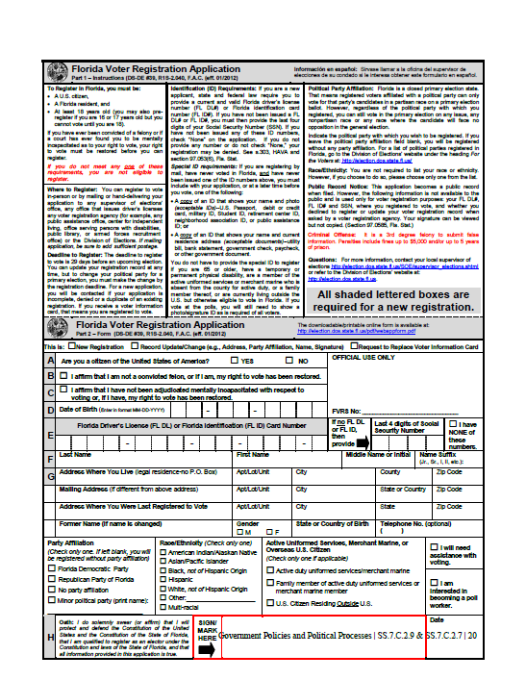
Look at your copy of the Florida Voter Registration Application.
What is the required information to be a registered voter?
Notes:
Make enough copies so pairs can look at one copy.

Slide 19
Students will recognize the requirements to run for local political offices
Take notes on the requirements in the Definition of Florida Elector box.
The minimum common requirements to be a candidate for local offices in Florida includes :
  being at least 18
  registered to vote
  signing the candidate oath
  paying filing fees
  Counties and cities may have additional political party affiliation paperwork and/or residential or age requirements to run for certain offices.

Slide 20

Let’s brainstorm….Jot down a list
Bell Ringer
Friday
10/9/15
Should there be any other qualifications for candidates running for political office?

Slide 21

Label your graphic Organizer
Experience
Issue Based Platform
Qualifications
Debates
Political Ads

Slide 22
analyze and evaluate the qualifications of candidates for public office
Everyone needs a copy of this graphic organizer.
Add our class-generated list of additional qualifications in the center box of the graphic organizer.

Slide 23
EXPERIENCE.
Where would you look to find out more information about someone’s experience?
When considering someone for a political office, what type of experience are you looking for the candidate to have?
Experience
Occupations: lawyer, public official, soldier
Think-Pair-Share:
Discuss your responses with your shoulder partner.

Slide 24
Occupations of u.s. presidents
Look at the chart and write down in the EXPERIENCE box on their graphic organizer some common occupations you see.
Notes:
Provide enough copies of the chart for at least one per table group to share.

Slide 25
Occupations of u.s. presidents
TIMED PAIR SHARE: Share your responses with your face partner. You have 30 seconds each!
Why do you think there are common occupations among presidents?
How might these occupations provide important experience to prepare someone to be the leader of the country?

Slide 26
Fill in your Graphic Organizer
Add notes from your discussion to the EXPERIENCE box, add these underneath your occupations
Experience
Occupations: Lawyer, public official, soldier
Knowledge of the law, previous experience in public office, military experience

Slide 27
Bell Ringer Tuesday Oct 13th
1. Set up this week on Page _____ in your notebook
2. Look at the following question and tell me if the answer choice is correct or incorrect and why.
In the modern political system, which issue represents a basic disagreement between Republicans and Democrats?
A. How often we have national elections

Slide 28
Bell Ringer Wednesday Oct 14th
Look at the following question and tell me if answer choice B is correct or incorrect and why.
In the modern political system, which issue represents a basic disagreement between Republicans and Democrats?
A. How often we have national elections
B. The legality of the U.S. Constitution

Slide 29
Bell Ringer Thursday Oct 15th
Look at the following question and tell me if answer choice C is correct or incorrect and why.
In the modern political system, which issue represents a basic disagreement between Republicans and Democrats?
A. How often we have national elections
B. The legality of the U.S. Constitution
C. The responsibilities of Government

Slide 30
ISSUE-BASED PLATFORM.
Why would you want to consider a candidate’s views on issues?
How would you find out information about their stance on issues?
Issue-Based Platform
Think-Pair-Share:
Discuss your responses with your shoulder partner.

Slide 31
Issue-based platform
One way to learn about the major issues that a candidate might discuss is by looking at their political party’s website.
Although a candidate does not necessarily have to speak on these issues, or agree with their political party’s stance on the issues, it is a helpful way to see some of the major issues that will be discussed during an election.

Slide 32
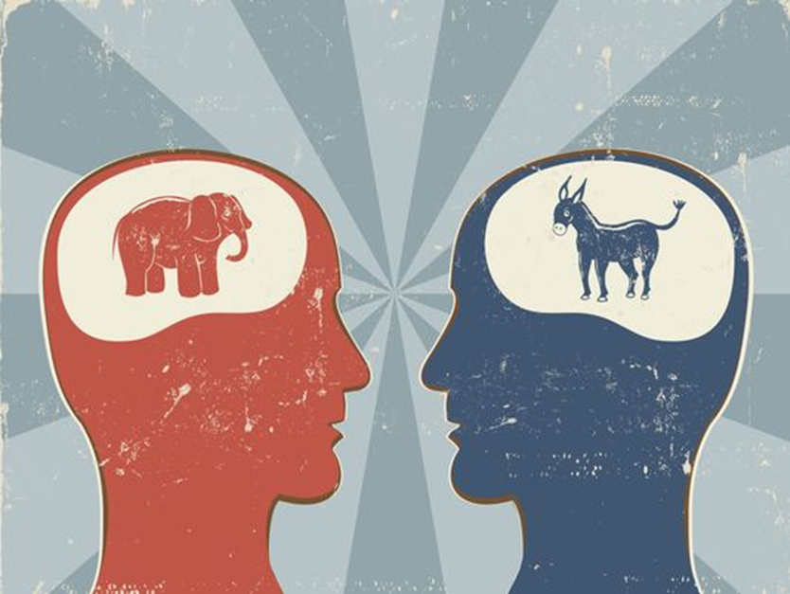
Issue-based platform
Democratic Party
Republican Party
Identify some of the issues they see listed from both websites.
Based on the lists, share some of the issues you think are important to know about when considering a candidate for office.
Notes:
For the Democratic Party, hover over the “Issues” headline at the top of the page. For the Republican Party, scroll down to the bottom of the page to view a list of issues. As an alternative, during an election year instead of showing the party websites use actual candidate websites

Slide 33
Issue-Based Platform
Write a complete sentence in the “Issue Based Platform” box explaining why a candidate’s stance on issues is an important qualification to consider.

Slide 34
Summarize this quote and share with your shoulder partner
"Television is no gimmick [trick], and nobody will ever be elected to major office again without presenting themselves well on it." – Television producer and Nixon campaign consultant Roger Ailes, 1968

Slide 35
DEBATES.
Presidential debates have become an important component of presidential campaigns.
As we watch these video clips, take notes on your graphic organizer about why debates play an important role in evaluating a candidate.
Debates

Slide 36
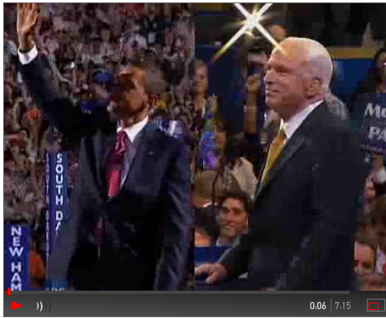
debates
PBS CLIP
Notes:
Start at 0:45 and end at 2:32. Teacher note: this video was made in preparation for the 2008 debates. In this clip the 2008 debate locations are mentioned.

Slide 37
Debates
PBS video– you learn how a candidate presents themselves, you can learn how they think about issues

Slide 38
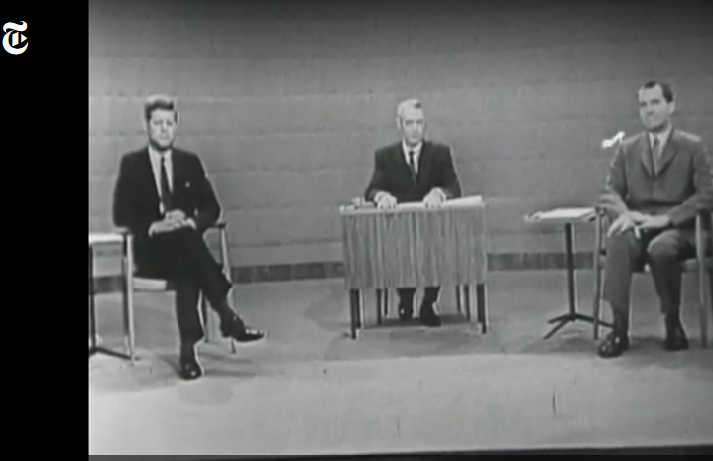

NY TIMES CLIP
debates
Notes:
Start at 2:18 and end at 4:20. Teacher note: this video begins with a 30 second commercial advertisement, be sure to cue the video before class. This video
begins with three debate examples and then concludes with a summary of the importance of debates for voters.

Slide 39
Debates
PBS video– you learn how a candidate presents themselves, you can learn how they think about issues
NY Times– you see an candidates personality and character. Unscripted moment.

Slide 40
write a summary statement on YOUR graphic organizer about the importance of debates in evaluating candidates and how this quote relates to debates.
"Television is no gimmick [trick], and nobody will ever be elected to major office again without presenting themselves well on it." – Television producer and Nixon campaign consultant Roger Ailes, 1968

Slide 41
$896 million was spent in 2012 in one area for candidates to inform voters about themselves and the opponent
What do you this money was spent on?
Campaign advertisements or Political advertisements
Why do they think so much money is spent on these advertisements?
Timed-Round-Robin: Share your responses to this last question with your teams.

Slide 42
POLITICAL ADS.
We will look at a few examples of political advertisements to get a better understanding of how advertisements can play a role in evaluating candidates.
Take notes on what you learn about the candidates for each advertisement you view.
Political Ads

Slide 43
Liberty Park/Hope Campaign 80 (Reagan, Republican, 1980)
What do you think is the message for this ad?
What do you learn about the candidate?”
Notes:
The link will bring you to the general page for the election year specified. Hover over the ads for the candidate to find the specific ad listed

Slide 44
Next Century (Clinton, Democrat, 1996)
What do you think is the message for this ad?
What do you learn about the candidate?”
Notes:
The link will bring you to the general page for the election year specified. Hover over the ads for the candidate to find the specific ad listed

Slide 45
Hopeful (Bush, Republican, 2000)
What do you think is the message for this ad?
What do you learn about the candidate?”
Notes:
The link will bring you to the general page for the election year specified. Hover over the ads for the candidate to find the specific ad listed

Slide 46
Determination (Obama, Democrat, 2012)
What do you think is the message for this ad?
What do you learn about the candidate?”
Notes:
The link will bring you to the general page for the election year specified. Hover over the ads for the candidate to find the specific ad listed

Slide 47
Write a summary statement about why voters use political advertisements to evaluate candidates.
Political Ads

Slide 48

create a title for the whole graphic organizer, share out.

Slide 49
write a well-crafted response using one of the following prompts:
Prompt 1
Using your graphic organizer, write a well-crafted paragraph explaining how understanding a candidate’s experience, platform, performance in debates and their political advertisements provide important information when evaluating a candidate for office.
Prompt 2
You overhear a friend say, “It doesn’t matter who you vote for. All candidates are the same.” Using what you have learned during this lesson and citing specific evidence, write a well-crafted explanation of how you would respond to your friend.
OR

