Slide 1
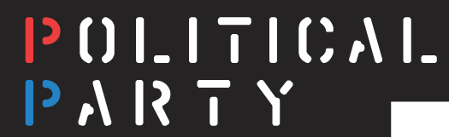
SS.7.C.2.8 Identify America’s current political parties, and illustrate their ideas about government.
Students will compare current political parties’ ideas about government.
Students will evaluate the impact political parties have on society, government, or the political system.

Slide 2
What are America’s current political parties? What are their ideas about government?
Everyone needs a copy of this activity sheet!

Slide 3
What are America’s current political parties? What are their ideas about government?
While reading the first two paragraphs, CIRCLE the academic vocabulary terms.

Slide 4
What are America’s current political parties? What are their ideas about government?
While reading about each political party, UNDERLINE their ideas about government.
Notes:
Model the first party with students.

Slide 5

What are America’s current political parties? What are their ideas about government?
Communist Party USA
a political party that believes the government should control all production and distribution of goods and working people should control their own lives and destinies a third party
As I read aloud about each political party, UNDERLINE their ideas about government.
Notes:
Model first political party with students.

Slide 6
What are America’s current political parties? What are their ideas about government?
Timed Round Robin
Each person in your group will read aloud about a political party. After reading, everyone will underline their ideas about government.
You have ONE MINUTE EACH, listen for the timer to switch ☺
Notes:
Set timer for one minute and tell students to switch. Students should complete entire reading and text marking activity in 4 minutes.

Slide 7
What are America’s current political parties? What are their ideas about government?
In the space below your graphic organizer, compare the current political parties’ ideas about government. Use your text-marking and ideas from discussion. You have five minutes!

Slide 8
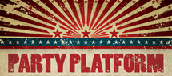
What are America’s current political parties? What are their ideas about government?
A party platform outlines a party’s beliefs and perspectives on issues related to government.

Slide 9
What are America’s current political parties? What are their ideas about government?
Everyone needs a copy of this activity sheet!
In order to learn more about the ideas of the two major parties, we are going to compare their ideas about government on important issues.

Slide 10
Comparing Perspectives
We will read excerpts from the 2012 Democratic and Republican party platforms to understand their perspectives on some of the powers granted to the federal government.
These are related to government’s powers as outlined in the U.S. Constitution.

Slide 11
Comparing Perspectives
Congress has the power to lay (create) and collect taxes.
Powers of the Federal Government | DEMOCRATIC PARTY PLATFORM | REPUBLICAN PARTY PLATFORM
TAXES Lays (creates) and collects taxes | In order to reduce the deficit while still making the investments we need in education, research, infrastructure, and clean energy, the President has asked for the wealthiest taxpayers to pay their fair share. The Democratic Party opposes efforts to give additional tax cuts to the wealthiest Americans at the expense of the middle class and investments in our future. | Extend the 2001 and 2003 tax relief packages—commonly known as the Bush tax cuts—pending reform of the tax code, to keep tax rates from rising on income,.. We call for a Constitutional amendment requiring a super-majority for any tax increase, … so that future Congresses cannot balance the budget by raising taxes.
SUMMARY

Slide 12
Comparing Perspectives
What do we think is the main idea? How can we summarize the perspective of the Democrats on TAXES?
The Democrats want fairness in the tax system, make everyone pay their fair share
Notes:
Model the first platform summaries with students.

Slide 13
Comparing Perspectives
What do we think is the main idea? How can we summarize the perspective of the Republicans on TAXES?
The Republicans want to extend tax cuts for the wealthy and propose an amendment regarding raising taxes to balance the federal budget
Notes:
Model the first platform summaries with students.

Slide 14
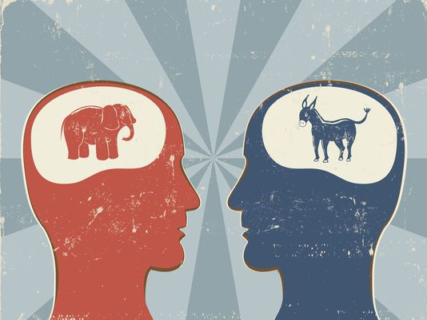
Comparing Perspectives Stations
With your shoulder partner, you will rotate to five stations that are focused on different topics in the party platform.
At each station, read the Democratic and Republican perspective.
Then, with your partner, come to consensus on the main idea and write that down in the “SUMMARY” section on your activity sheet.
You will have two minutes at each station! Listen for the timer to rotate.
Notes:
Use the activity sheet to make larger copies of each party statement on the topics. Use these to create stations that students will rotate to.

Slide 15
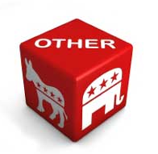
Functions of Political Parties
Now that we know the basic ideas of each party, what do you think they do with these ideas???
TIMED PAIR SHARE: With your face partner, share out some things you think you know about the function of political parties.
You have 30 seconds each!

Slide 16
Impact of Political Parties
Everyone needs a copy of this reading!
As we read, we are going to UNDERLINE the impact.
Impact = functions that influence our government, society, or political system
Notes:
Read and model with first two paragraphs.

Slide 17

Impact of Political Parties
Political parties play a major role and have a large impact in American society. Political parties are important to the democratic process because they help people to communicate their ideas about government. Because political parties are made up of large groups of people, their group’s ideas can be more easily heard by the government.
Political parties impact the government at the federal, state, and local levels. Because there are many more elected offices at the state and local levels, political parties tend to be more active at these levels. A party can link its members at the federal, state and local levels of government to achieve big goals for the party. This function provides a way for people that identify with a particular party to connect with each other and for the party to expand its influence at each level of government.

Slide 18
Impact of Political Parties
Read the remaining four paragraphs with your shoulder partner.
As you read, continue to UNDERLINE any impact.

Slide 19
Impact of Political Parties
Using your reading, explain in your own words how each function of political parties can impact our society, government, or political system.
Notes:
Model the first example with students.

Slide 20
Impact of Political Parties
Complete the last four functions on your own.
Remember, explain in your own words how each function of political parties can impact our society, government, or political system.
You have 8 minutes!

Slide 21
Checking for Understanding
Prompt
Using what you have learned during this lesson and using specific examples from your notes and readings, write an argument explaining the impact of political parties on society, government or the political system. Use specific examples and evidence to support your argument.

