Slide 1
MEDIA AND POLITICAL COMMUNICATION

Slide 2
SS.7.C.2.11: Analyze media and political communications (bias, symbolism, propaganda).
Students will use scenarios to identify bias, symbolism, and propaganda.
Students will evaluate how bias, symbolism, and propaganda can impact public opinion.

Slide 3
Media
On your notebook paper, write a complete sentence to answer each of the following questions.
What is meant by the term media?
What are the different types of media?
Notes:
Discuss using this type of brainstorming activity as a bellringer. Discuss other options of things you can

Slide 4
Media
Check and correct yourself
Media (noun)
plural form of the word “medium,” refers to various means of communication.
For example, television, radio, and the newspaper are different types of media.
The term can also be used as a collective noun for the press or news reporting agencies.

Slide 5
Think about …
Brainstorm about your favorite commercial on television or advertisement in a magazine or online.
Write down your answers to the following questions on your notebook paper. Yes, you can make a list or bullets or use complete sentences.
Why do you like the commercial?
How does it make you feel after viewing it?
Does the commercial convince you to buy the product?
Why or why not?

Slide 6
Discuss …
You are going to share your responses with your shoulder partner.
Get your paper and a writing utensil
Stand Up and Pair Up
The person with the birthday closest to today goes first
SHARE - Why do you like the commercial? How does it make you feel after viewing it? Does the commercial convince you to buy the product? Why or why not?

Slide 7
Determine …
Write down any similarities or differences between your answers?
Some possible similarities are:
Did the advertisements make you both feel ____ ?
Did you both like the commercials for the similar reasons?
Did you both decide to purchase the products?

Slide 8
Think about …
Why does it matter if there were similarities or differences in our answers?
What is the relationship between our similarities or differences and media or political communications?
Brainstorm possible answers to the following question on your notebook paper. Yes, you can make a list or bullets or use complete sentences.

Slide 9
Media and Political Communications
Various techniques are used in media and political communication to convey messages or convince the audience to think or feel a certain way.
Keep in mind that the public learns most of its information about government from the media.

Slide 10
The information transmitted through the media, and by government and other political institutions such as interest groups, candidates and political parties, is all understood as political communication.
Write a complete sentence that explains political communication.

Slide 11
Think about … Write about …
Are there any similarities between the presidential campaign logos from 2012 - 1992?
Write down, in a list, any similarities you observe, while I am scrolling down the page.
http://www.downwithdesign.com/logo-design/20-years-presidential-election-campaign-logos/

Slide 12
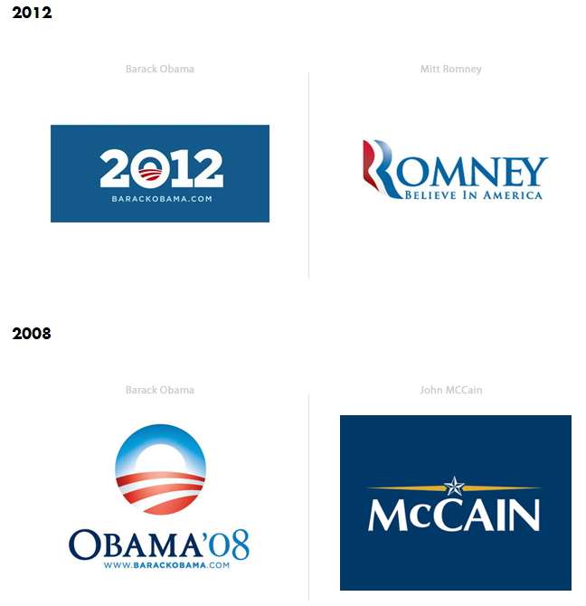

Slide 13
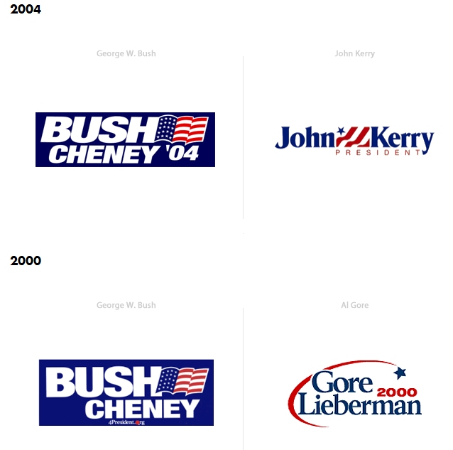

Slide 14
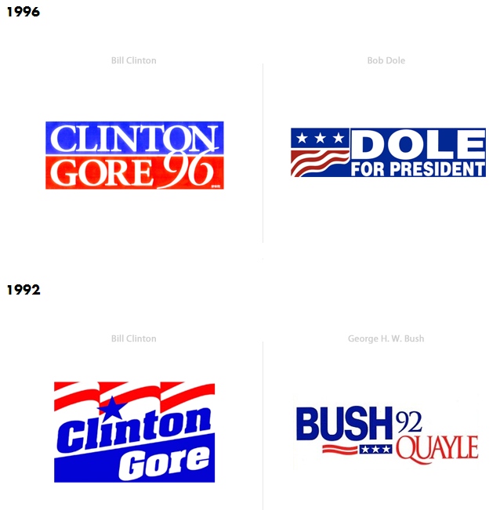

Slide 15
Think about … Write about…
Are there any similarities between the presidential campaign logos from 2012 - 1992?
Write down, in a list, any similarities you observed, while I scrolled down the page.
http://www.downwithdesign.com/logo-design/20-years-presidential-election-campaign-logos/

Slide 16
Think about … Write about …
Brainstorm possible answers to the following question on your notebook paper. Yes, you can make a list or bullets or use complete sentences.
Why do you think candidates use the colors red, white, and blue and stars and stripes in their logos?
What message do you think they are trying to convey by using these colors and images?
Is there a feeling or emotion that the logos convey?

Slide 17
Media and Political Communication
The role of the media in presenting information is often not balanced—the media may present information in a way that favors one perspective (“bias”), advocates a clear point of view or action (“propaganda”), or references or presents images to serve as information shortcuts (“symbolism ”).
Write the main ideas from the statement above on your paper.
Notes:
This slide highlights the programs and resources we have developed to assist in the development of knowledgeable, responsible, and actively engaged citizens. It is our goal to provide you with the information, content knowledge, pedagogy, and resources you need.

Slide 18
Reminder …
The information transmitted through the media, and by government and other political institutions such as interest groups, candidates and political parties, is all understood as political communication.

Slide 19
Media and Political Communication Reading
Everyone needs a copy of the reading

Slide 20
1st Number the Paragraphs in the Reading
1 When ………
2 Bias is ……..
3 Bias in ……..
4 Symbolism ...
5 (the chart) …
6 Propaganda

Slide 21
Media and Political Communication Reading
Directions for the reading:
While I read the text aloud, each person should text code the academic vocabulary as they read the passage silently:
V for Vocabulary (academic vocabulary)
Which words are academic domain vocabulary words? Generally, academic vocabulary words are key words that must be understood in order to comprehend the subject area specific content.
In this reading, the academic vocabulary are primarily the words related to media and political communications.
Notes:
Read aloud the text and then complete a think aloud to explain which words you marked up and why.

Slide 22
Example of Text Coding Vocabulary in Media and Political Communication Reading
V
V
V
V
Notice there are V’s located next to the words that are central to comprehending this reading.
There may be additional academic terms noted with V’s.

Slide 23
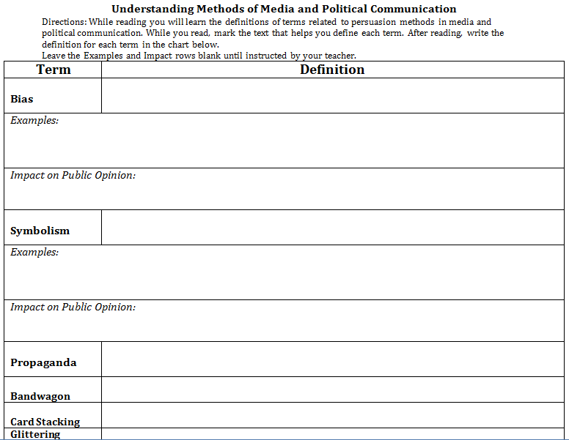
Media and Political Communication Activity Sheet
Everyone needs a copy of the activity sheet.

Slide 24
Media and Political Communication Activity Sheet
Directions for the activity sheet:
While reading you will learn the definitions of terms related to persuasion methods in media and political communication.
While you read, mark the text that helps you define each term with a D. After reading, write the definition for each term in the chart below.
Leave the Examples and Impact rows blank for now!
Leave these two rows BLANK – for now
Notes:
Have students read with a partner to mark up the definitions.

Slide 25
Example of Text Coding Vocabulary (V) and Definitions (D) in Media and Political Communication Reading
V
V
V
V
D
Notice there is a D located at the beginning of the section that helps to define the term.

Slide 26
Independently complete the definitions portion of the Understanding Methods of Media and Political Communications activity sheet

Slide 27
Which option presents a clear point of view?
A. bias
B. metaphor
C. propaganda
D. symbolism

Slide 28
Think about …
The presidential campaign logos we examined earlier in the lesson.
http://www.downwithdesign.com/logo-design/20-years-presidential-election-campaign-logos/
Which persuasion technique is exemplified in the presidential campaign logos?

Slide 32
Which persuasion technique is exemplified in the presidential campaign logos?
Bias, Symbolism, or Propaganda
Write about …
in the appropriate Examples box on the activity sheet
Write a sentence explaining how the campaign logos use that persuasion technique in the Example box.

Slide 33
Discuss …
How might the use of symbols in political communication, such as campaign logos, impact public opinion?
Write …

Slide 34
Think about …
Media and Political Communication
We are going to look at newspaper headlines in the Newseum Today’s Front Pages Project from a specific day in history –
Wednesday, November 7, 2012 (the day after Election Day)
How do the headlines vary?
Are both candidates mentioned?
Which persuasion technique is exemplified?

Slide 35
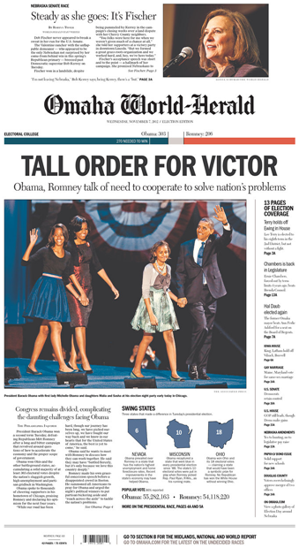

Slide 36
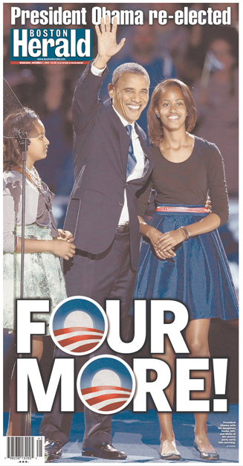

Slide 37
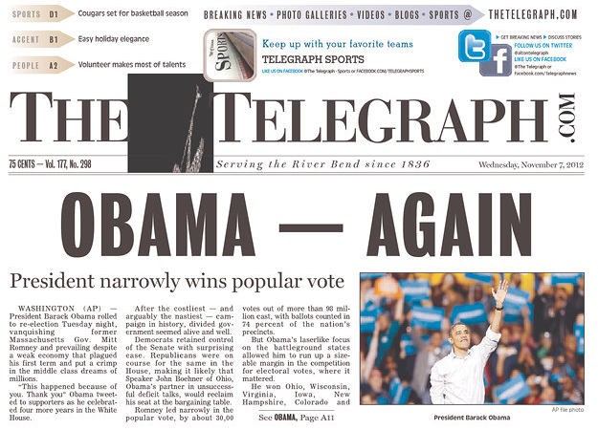

Slide 38
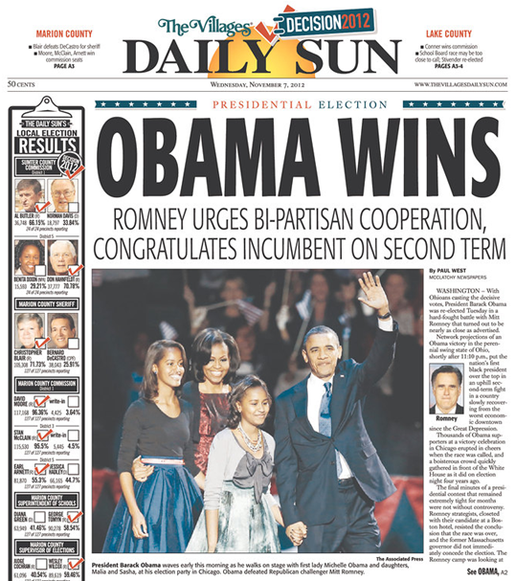

Slide 39
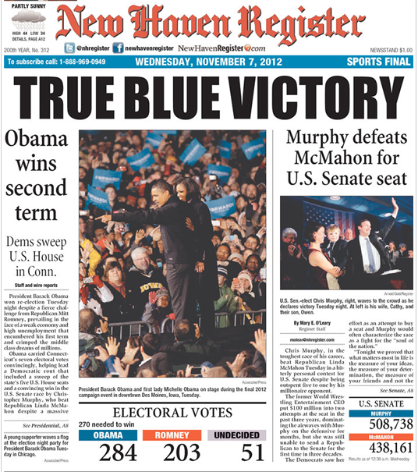
http://www.newseum.org/todaysfrontpages/hr_archive.asp?fpVname=CT_NHR&ref_pge=gal&b_pge=3

Slide 40
Think about …
Which persuasion technique is exemplified in the newspaper headlines?
Bias, Symbolism, or Propaganda
What evidence can you point to in the reading to explain your answer?
Share your evidence with your shoulder partner.

Slide 41
Discuss …
How do the headlines vary?
Are both candidates mentioned?
Which persuasion technique is exemplified?
What evidence from the reading did you use to determine the persuasion technique?

Slide 42
Think about …
What are specific examples, from the newspaper headlines, of the use of bias in media communication?
Write …
During the discussion, take notes on the activity sheet in the Examples box under bias.

Slide 43
Does this front page have a bias?
How do you know?
Is there an opinion or preference being expressed on the front page?
Is there a clear emotion being expressed by the front page?

Slide 44
Does this front page have a bias?
How do you know?
Is there an opinion or preference being expressed on the front page?
Is there a clear emotion being expressed by the front page?

Slide 45
Does this front page have a bias?
How do you know?
Is there an opinion or preference being expressed on the front page?
Is there a clear emotion being expressed by the front page?

Slide 46
Does this front page have a bias?
How do you know?
Is there an opinion or preference being expressed on the front page?
Is there a clear emotion being expressed by the front page?

Slide 47
Does this front page have a bias?
How do you know?
Is there an opinion or preference being expressed on the front page?
Is there a clear emotion being expressed by the front page?

Slide 48
Think about …
How might the use of bias in media communication, such as newspaper headlines, impact public opinion?

Slide 49
Write about …
Respond to the question below by writing a summary sentence in the Impact on Public Opinion box under Bias.
Many Americans get their news from the newspaper. What might be the impact on public opinion if a newspaper’s front page has a bias?

Slide 50
Discuss …
You are going to share your summary sentence with your “9:00 Buddy”
Get your paper
Stand Up and Pair Up
The person with the longest hair goes first
What might be the impact on public opinion if a newspaper’s front page has a bias?

Slide 51
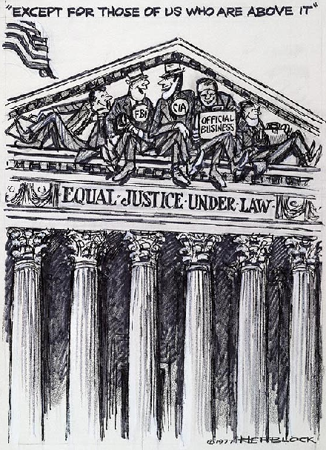
BELL WORK ----------------------------PAGE 26
Answer the following questions
List the objects you see in the cartoon
What is the caption or title
Locate 3 words or phrases used by the cartoonist to identify objects or people within the cartoon
Record any important dates or numbers that appear in the cartoon

Slide 52
Return to your seat … Thank you ☺

Slide 53
Media and Political Communication
We are going to examine a political cartoon by Herbert Block.
The Library of Congress maintains a digital exhibit of his political cartoons.
Political cartoons are generally found newspapers or periodicals and symbolize some action, subject, or person of popular interest related to the government or public affairs.

Slide 55
Think about …
What do you think is symbolized in this cartoon?
In order to effectively analyze this cartoon we are going to use a resource from the National Archives.

Slide 56
Everyone needs a copy of the
Cartoon Analysis Worksheet

Slide 57
Think about … Write about …
Complete Level 1 Visuals #1
Complete Level 1 Words #1, 2, 3
Complete Level 2 Visuals #2 and 3
Complete Level 2 Words #4 and 5
Complete Level 3 A
Complete Level 3 B
Complete Level 3 C
Complete Level 3 D
Notes:
MODEL!

Slide 58
How did we do???
This cartoon was created in 1977 in reaction to the CIA and FBI being investigated for keeping Americans under surveillance.
The artist, Herb Block, commented, "Unwarranted secret operations and snooping in the interest of ‘security' have contributed to making Americans feel less secure."

Slide 59
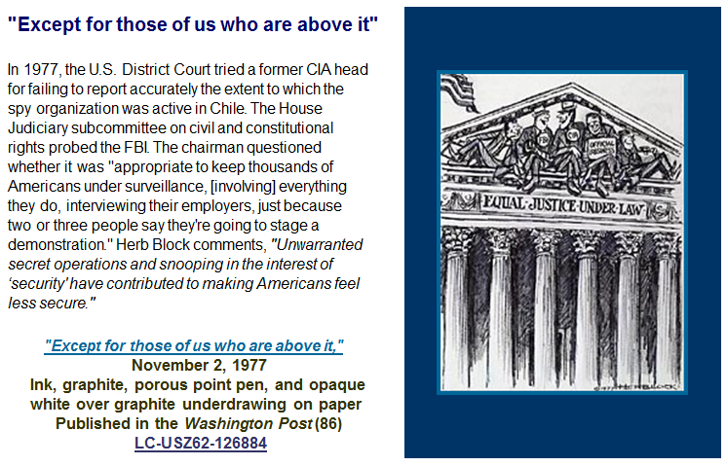
http://www.loc.gov/rr/print/swann/herblock/one.html

Slide 60
Think about … Write about …
What types of persuasion techniques are used in this cartoon?
Write your response on the top of the Cartoon Analysis Worksheet.
What symbols are being used?
Add symbols to Level 2 Visuals #2 that you may have missed.

Slide 61
Think about … Write about …
Based on what you observed and learned about the background of this cartoon, what is the bias in this cartoon?
Write your response as summary sentence that explains the bias in the cartoon at the bottom of the cartoon analysis worksheet.

Slide 62
Discuss …
You are going to share your summary sentence with your face partner.
What is the bias in this cartoon?

Slide 63
Everyone needs a copy of the
Cartoon Analysis Worksheet

Slide 64
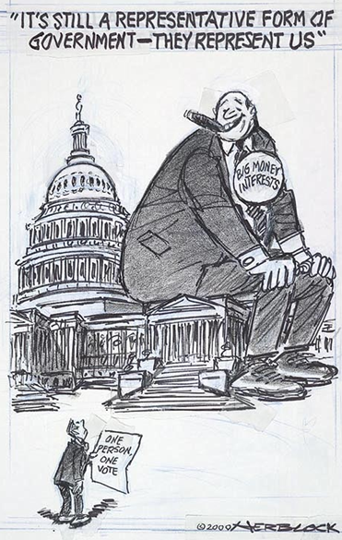
What do we know about this cartoon?
Herb Block, the artist has stated "that there is nothing free about sales of public office to high bidders, who buy and pay for elections and influence.“
There is a concern in the United States regarding soft money and the ability of national political party organizations to raise unlimited funds for political advertisements.
Some believe that this leads to elections being “bought” by donors who give the most money in return for favors.

Slide 65
Pair up …
You are going to complete the Cartoon Analysis Worksheet with your “5:00 Buddy”
Get your paper and a writing utensil
Stand Up and Pair Up

Slide 66
Every set of clock buddies needs a copy of the cartoon

Slide 67
Work with your clock buddy to
analyze the political cartoon,
“It’s still a representative form of government – they represent us”
Complete the
Cartoon Analysis Worksheet

Slide 68
Return to your seat … Thank you ☺

Slide 69
Think about … Write about …
Based on what you observed in the cartoon and learned about the background of this cartoon, what is the bias in this cartoon?
Write your response as summary sentence that explains the bias in the cartoon at the bottom of the cartoon analysis worksheet.

Slide 70
Think about …
How might the use of bias and symbolism in media and political communication, such as political cartoons, impact public opinion?

Slide 71
Think about … Share out …
Which persuasion technique was exemplified in the presidential campaign logos?
Symbolism
Which persuasion technique was exemplified in the newspaper headlines?
Bias
Which persuasion techniques were exemplified in the political cartoons?
Bias and Symbolism

Slide 72
Which persuasion technique in media and political communication have we not examined?
Review the reading – Political and Media Communication – to determine your answer
Review the activity sheet – Understanding Methods of Media and Political Communications – to refresh your memory about propaganda

Slide 73
Propaganda
Government agencies used propaganda techniques for different areas of need throughout history but especially during World War I and World War II.
What is the difference between the use of bias and propaganda?
What evidence can you point to in the reading to explain your answer?
Share your evidence with your shoulder partner.

Slide 74
Media and Political Communication
We are going to examine a propaganda poster created during World War I by the United States Food Administration.
The National Archives maintains digitized versions of many resources, including this poster.

Slide 75
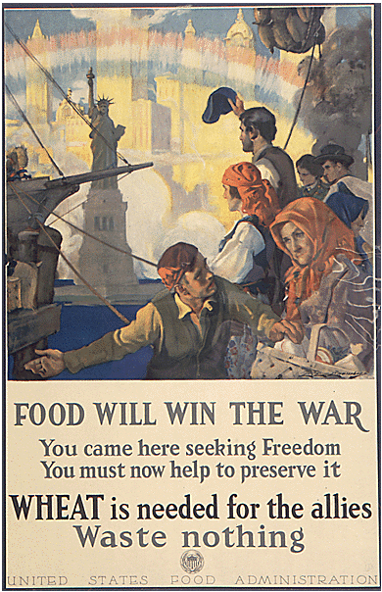

Slide 76
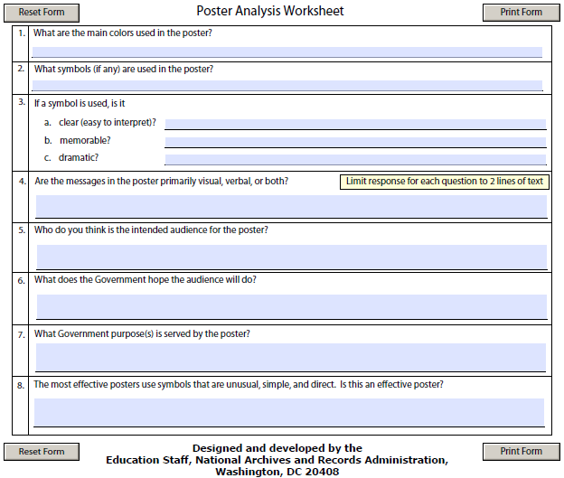
Everyone needs a copy of the
Poster Analysis Worksheet

Slide 77
Think about … Write about …
Independently answer Question 1
Independently answer Question 2
We will answer Question 3 (A-C) as a class
Independently answer Question 4
Independently answer Question 5
Independently answer Question 6
Independently answer Question 7
Independently answer Question 8

Slide 78
Think about … Share out … Write about
Take notes during this discussion on the edges of your Poster Analysis Worksheet
Which propaganda techniques are used in this poster?
transfer
According to the reading, what is “transfer”?
plain folks
According to the reading, what is “plain folks”?
glittering generalities
According to the reading, what is “glittering generalities”?
What emotion is being conveyed?

Slide 79
Think about … Write about …
How might this poster impact a viewer and public opinion during the war?
Write your response as summary sentence at the bottom of the poster analysis worksheet.

Slide 80
Everyone needs a copy of the
Poster Analysis Worksheet

Slide 81
Pair up …
You are going to complete the Poster Analysis Worksheet with your “7:00 Buddy”
Get your paper and a writing utensil
Stand Up and Pair Up

Slide 82
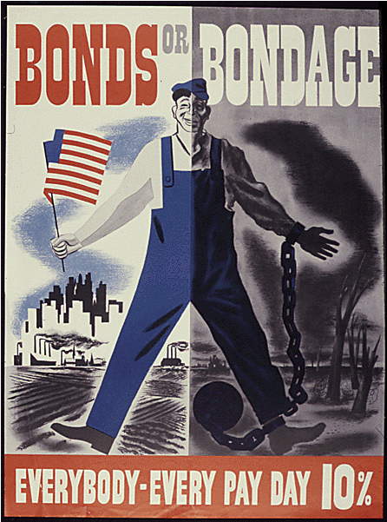
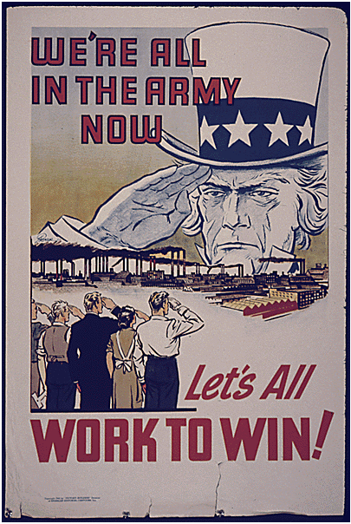
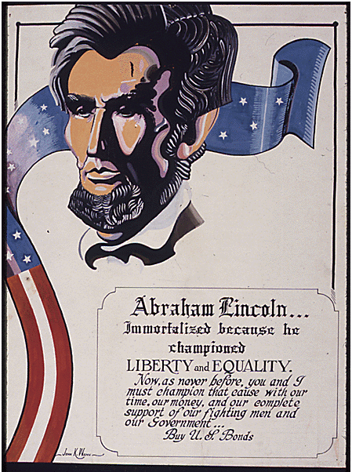
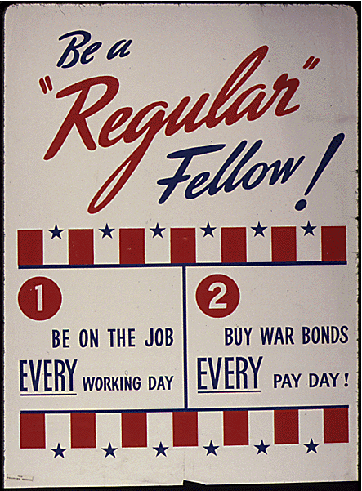
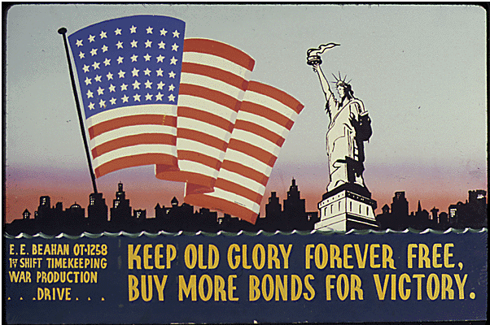
Every set of clock buddies needs one of the posters
Notes:
“Be Patriotic sign your country’s pledge to save the food” (transfer, glittering generalities, name calling) http://research.archives.gov/description/512497
“We’re All in the Army Now” (bandwagon, transfer) http://research.archives.gov/description/533998
Bonds or Bondage. Everybody Every Pay day. 10 Percent. (card stacking, transfer) http://research.archives.gov/description/534069
Abraham Lincoln (testimonial) http://research.archives.gov/description/534342
Be a Regular Fellow (plain folks) http://research.archives.gov/description/534107
Keep Old Glory Forever Free, Buy More Bonds for Victory (transfer) http://research.archives.gov/description/534098
Join the Parade of Winners (bandwagon, glittering generalities) http://research.archives.gov/description/534238

Slide 83
Work with your clock buddy to
analyze the poster.
Complete the
Poster Analysis Worksheet

Slide 84
Think about … Write about …
Write your answers in complete sentences at the bottom of the Poster Analysis Worksheet.
Which propaganda technique(s) is being used in the poster?
What is the intended emotion this poster is trying to convey?
How might this poster impact public opinion during the time this poster was released?

Slide 85
Propaganda
Take notes during this discussion on the Understanding Methods of Media and Political Communication activity sheet.
Each of the posters will be projected
The students assigned to each poster will SHARE
the propaganda technique for their assigned poster
the impact the poster might have on public opinion
Remember to take notes during this discussion on the Understanding Methods of Media and Political Communication activity sheet.

Slide 92
Return to your seat … Thank you ☺

Slide 93
Think about …
Essential Questions
What types of communication techniques and methods are used in media and political communication?
How can these techniques impact public opinion?
Learning Goals/Benchmark Clarifications
Students will use scenarios to identify bias, symbolism, and propaganda.
Students will evaluate how bias, symbolism, and propaganda can impact public opinion.

Slide 94
Write about …
Write a well-crafted informative response to the following prompt:
Using what you have learned from this lesson, explain how bias, symbolism, and propaganda can be used to impact public opinion.

Slide 95
Look at the items in the concept circle.
Write about your understanding of media and political communication by highlighting the connections between and among each of the items.
What is the significance of each one and how do the items fit together?
Media
Bias
Symbolism
Propaganda
Notes:
Alternative Vocabulary Assessment

