Slide 1
Federalism SS.7.C.3.4—identify the relationship and division of powers between the federal government and state governments

Slide 2
Federalism
In this lesson, students will be introduced to the concept of federalism by reading text, examining the US Constitution and applying their understanding to various examples and scenarios

Slide 3
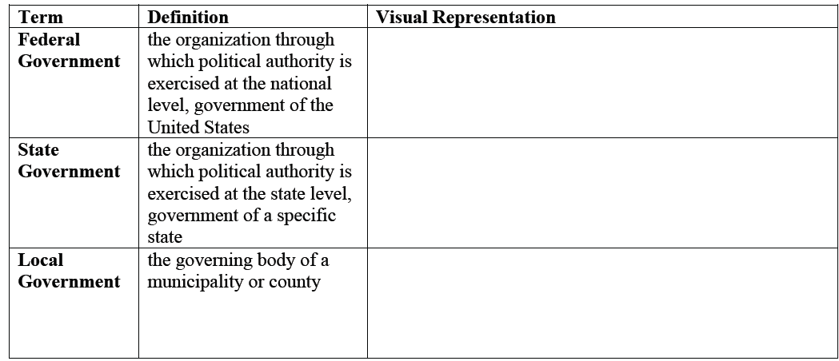
Federalism Vocabulary
Read each definition silently and draw a visual representation for each term

Slide 4
Federalism
Read aloud and share your visuals
Federal Govern
State Government
Local Government

Slide 5
Federalism
Add the notes below to your paper
Federalism is a core democratic principle of our government
In a federal system, the power of the government is distributed to different levels of government: national (federal), state, and local
The national government is also referred to as the federal government

Slide 6
federalism
Vocab review
Enumerated powers—Powers given to the federal government, listed in constitution
Concurrent powers—Powers shared by the state and federal government
Reserved powers—Powers given to the states by the federal government

Slide 7
Federalism—Read Aloud

Slide 8
After reading
After reading the two paragraphs on federalism the chart at the top of the back page define the term federalism in your own words

Slide 9
The 10th Amendment
The powers not delegated to the United States by the constitution, nor prohibited by it to the states, are reserved to the State respectively, or to the people.
Remember: Reserved powers have an S in the middle this will help you remember that they are STATE powers!

Slide 10
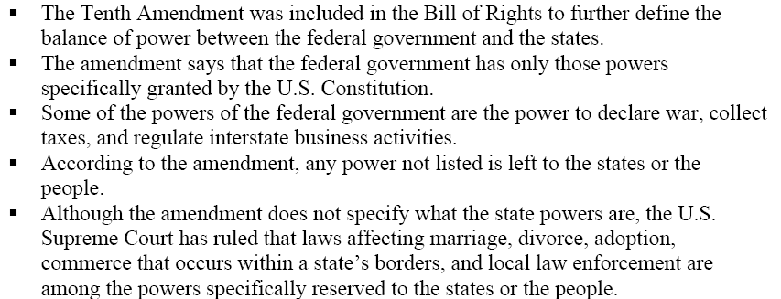
10th amendment

Slide 11
December 1st
The following slide goes along with “Whos got the power” lesson

Slide 12
Who has the power?
Citizens in the community have been asking questions and they aren't sure which level of government they should approach to have their questions answered.
your task is to identify the level of government (local, state, federal) and the type of power that level of government has to solve each of the questions.

Slide 13
Partner activity
You may work with a partner to complete all 10 questions.
Be prepared to explain your answer choices

Slide 14
Review discussion
Why is it important for citizens to know the powers of each level of government?
Why do you think different levels of government are responsible for different things?
What would be different if there was only a federal government and no state or local governments?

Slide 15
Scenarios
Read the following scenarios and determine if a federal, state, or concurrent power is being expressed

Slide 16
Superstorm Sandy
After Superstorm Standy in October 2012, President Obama worked with Governor Chris Christie of New Jersey and pledged federal support to help repair the massive strom damage throughout the state.
What is this an example of?
Concurrent power
Why is this an example of concurrent power?

Slide 17
Teaching requirements
Each state has its own rules and regulations for obtaining a teaching certificate. If a teacher living in Florida would like to move and teach in Texas, he or she would need to pass one or more exams in order to be certified to teach in Texas.
What is this an example of?
Reserved
Why do you think teaching certification requirements are a state decision?

Slide 18
Declaring war
The state of Montana borders Canada. If a conflict occurs between Montana and Canada, can Montana declare war on Canada?
Why or Why not?
No, because Declaring war is an enumerated power
What is the benefit of the federal government having the sole power to declare war rather than it being a concurrent or reserved power?

Slide 19
What happens if a state or local government writes a law which conflicts with the US Constitution or federal law?
The US constitution is the supreme law of the land and that a state or local government cannot make laws that conflict with the US Constitution or with laws passed by Congress. This is because of the Supremacy Clause

